Slide 1
ANURAG UNIVERSITY DEPARTMENT OF COMPUTER SCIENCE AND ENGINEERING
R Packages
B.Jyothi
Assistant Professor
Anurag University

Slide 2
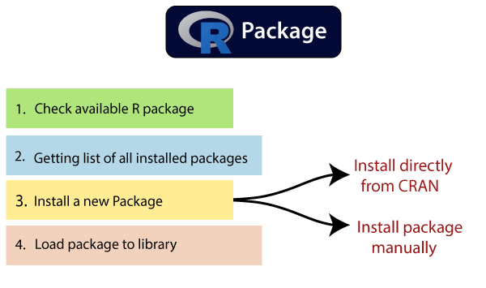
CONTENTS

Slide 3
R Packages
A package is a collection of R functions, data, and compiled code in a well-defined format.
In the R environment, these packages are stored under a directory called "library.“
There were over 14,000 packages available on the Comprehensive R Archive Network, or CRAN

Slide 4
What Are Repositories?
A repository is a place where packages are located and stored so you can install packages from it.
some of the most popular repositories for R packages are:
CRAN: Comprehensive R Archive Network(CRAN) is the official repository, it is a network of ftp and web servers maintained by the R community around the world.
Bio conductor: Bio conductor is a topic-specific repository, intended for open source software for bioinformatics.
Github: Github is the most popular repository for open source projects.

Slide 5
Installing an R Package
Installing Packages From CRAN
Install package manually

Slide 6
Installing Package from CRAN
The following command is used to get the packages directly from CRAN webpage and install the package in the R environment.
install.packages("Package Name")
In order to install more than a package at a time, we just have to write them as a character vector in the first argument of the install.packages() function
Ex: install.packages(c("vioplot", "MASS"))

Slide 7
Installing package manually
To install a package manually, we first have to download it from
https://cran.r project.org/web/packages/available_packages_by_name.html.
The required package will be saved as a .zip file in a suitable location in the local system.
Once the downloading has finished, we will use the following command:
install.packages(file_name_with_path, repos = NULL, type = "source")
Install the package named "XML"
install.packages("C:\Users\ajeet\OneDrive\Desktop\graphics\xml2_1.2.2.zip", repos = NULL, type = "source”

Slide 8
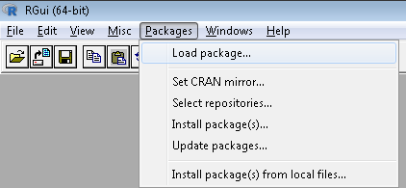
Installing Packages Using RStudio
In RStudio you will find it at Tools -> Install Package, and there you will get a pop-up window to type the package

Slide 9
Load Package to Library
We need to load the package in R after installing them to make them usable.
Use the following command to load the installed package:
library(package)
or
require("packagename")
The other is to call the function including the package name, like this:
packagename::functioname()

Slide 10
Unload a package
In R, you can unload a package by using detach() command, as follows:
detach(package:name)
Ex: detach("package:babynames", unload = TRUE)
Uninstalling a package :
remove.packages(),

Slide 11
Update and Check Installed Packages
To check what packages are installed on your computer, you can use: installed.packages()
You can check what packages need an update with a call to the function:
old.packages()
You can update all packages by using:
update.packages()
To update a specific package, type this command:
install.packages("PACKAGE NAME")

Slide 12
Update and Check Installed Packages
Check Available R Packages
libPaths()
Getting the list of all the packages installed:
library()
You can check what libraries are loaded in your current R session by typing into the console:
search()

Slide 13
To find out more about a package once you've installed it, type
help(package = "packagename")

Slide 14
THANK YOU

